Slide 1

NEWS CLASSIFICATION
Gokul Nagarajan
Karthik Selvaraj

Slide 2
OBJECTIVES
Classification of news articles using supervised Machine Learning (ML) and Natural Language Processing (NLP) techniques
Evaluate each classifier’s ability to select the appropriate category given an article’s title and a brief article description

Slide 3
INTRODUCTION
We selected the news dataset to retrieve the headlines

Slide 4
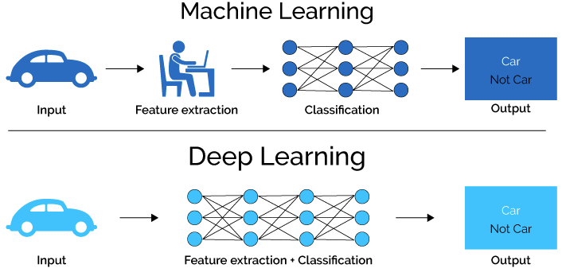
MACHINE LEARNING VS DEEP LEARNING
Machine learning is a subset of artificial intelligence associated with creating algorithms that can change themselves without human intervention
Deep learning is a subset of machine learning where algorithms are created and function similarly to machine learning, but there are many levels of these algorithms, each providing a different interpretation of the data it conveys. This network of algorithms is called artificial neural networks.

Slide 5
FEATURE EXTRACTION
This task requires us to extract features in the form of matrices (usable data format and that can be later used by various feature selection and Machine learning algorithms to correctly classify data into different classes).
1. TFIDFVectorizer() - TFIDF, term frequency–inverse document frequency, is the statistic that is intended to reflect how important a word is to a document in the corpus. This is used to extract the most meaningful words in the corpus.
2. CountVectorizer() - The collection of text documents is converted to a matrix of token counts using count vectorize that produces a sparse representation of the counts.

Slide 6
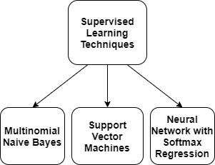
SUPERVISED LEARNING
Supervised classification of news articles is done because we have the defined classification categories.
The algorithm is trained on the labeled dataset and gives the desired output(the pre-defined categories)

Slide 7
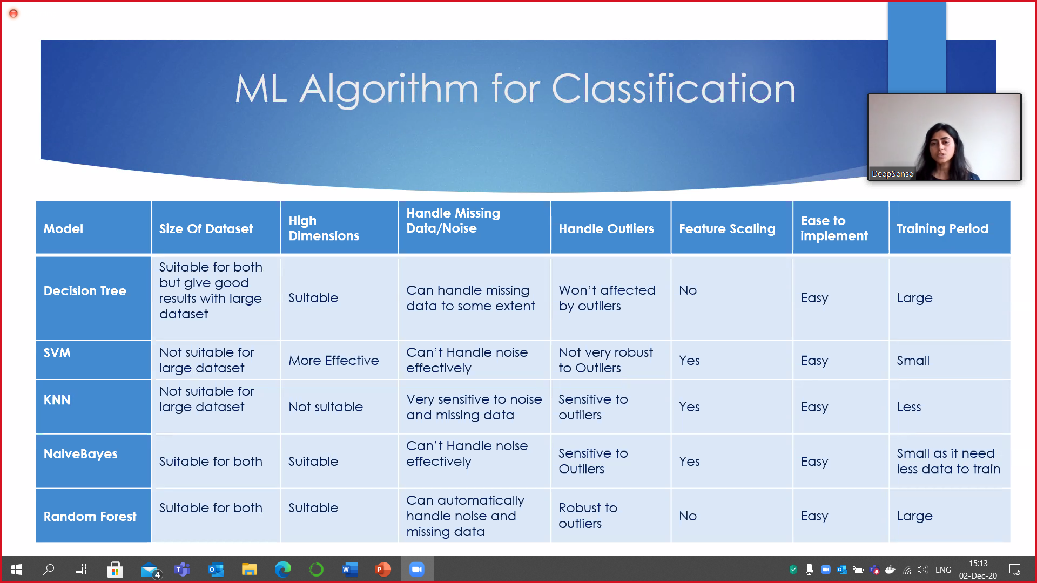
WHY we CHOOSE SVM and Naïve Bayes models are implemented?

Slide 8
MULTINOMIAL NAÏVE BAYES
The multinomial Naive Bayes implements the naive Bayes algorithm for multinomially distributed data and the classifier is suitable for classification with discrete features (e.g., word counts for text classification)
The multinomial distribution normally requires integer feature counts and fraction counts such as TF-IDF is used in practice.

Slide 9
SUPPORT VECTOR MACHINES
1. Linear SVC (Support Vector Classifier) is to fit to the data you provide, returning a "best fit" hyperplane that divides, or categorizes your data.
2. After obtaining the hyperplane, you can then feed some features to the classifier in order to acquire the "predicted" class.

Slide 10
NEURAL NETWORK WITH SOFTMAX REGRESSION
SoftMax layer is typically the final output layer in a neural network that performs multi-class classification.
SoftMax regression is a generalization of logistic regression that we can use for multi-class classification

Slide 11
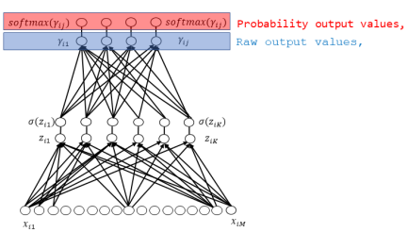
Neural network with softmax layer workflow mechanism

Slide 12
Programming LANGUAGE & PACKAGES USED
Python 3.0
Numpy
Pandas
sklearn

Slide 13
DATASET
TagMyNews Datasets is a collection of datasets of short text fragments that we used for the evaluation of our topic-based text classifier.
This is a dataset of ~32K English news extracted from RSS feeds of popular newspaper websites (nyt.com, usatoday.com, reuters.com).
Categories are: Sport, Business, U.S., Health, SciTech, World and Entertainment.

Slide 14
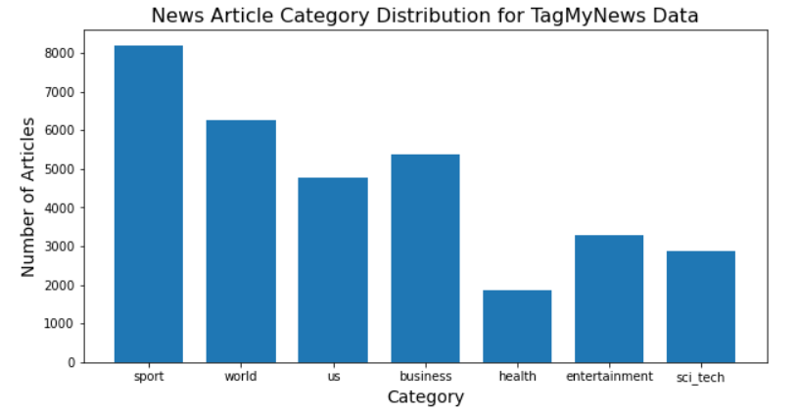
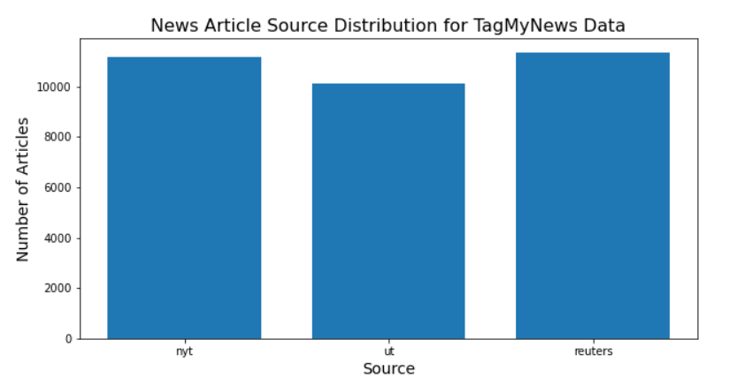

Slide 15
DATASET PREPROCESSING
Pre-processing the news article data involved three steps.
First, we separated each article’s title, description, and pre-labeled category into a separate text file, since the corpus is formatted into a single file.
Second, we removed all punctuation and stopwords from the title and description
We divided our data into training news articles and testing news articles. 75% of our data (24,453 articles) were designated as the training articles and the remaining 25% (8151 articles) were designated as the testing articles.

Slide 16
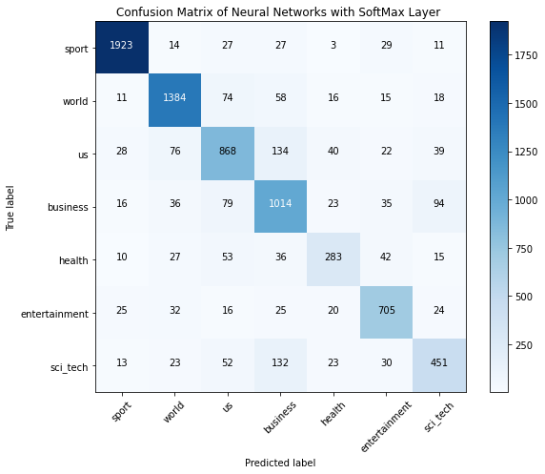

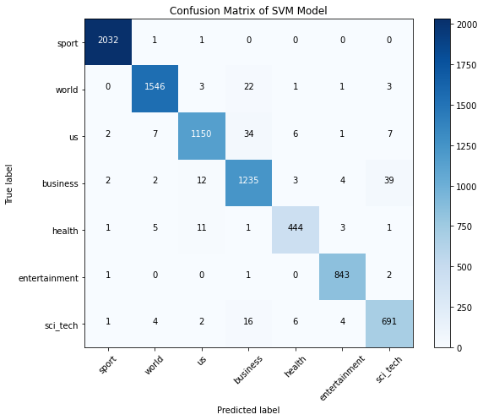
Confusion matrix

Slide 17
CONFSION MATRIX

